Slide 1
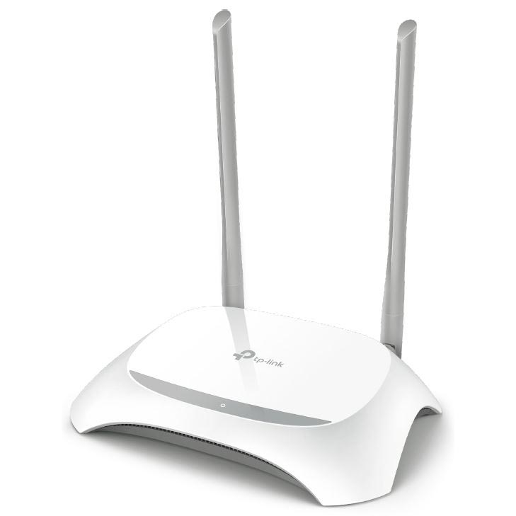
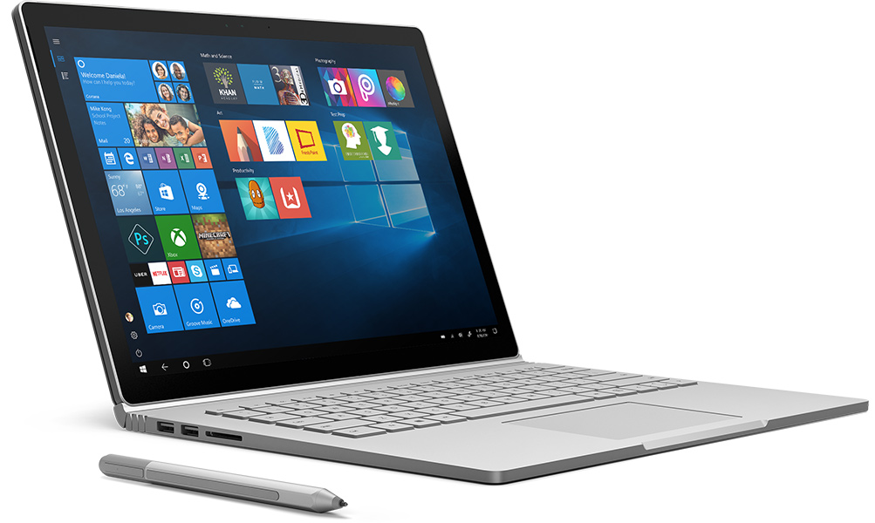
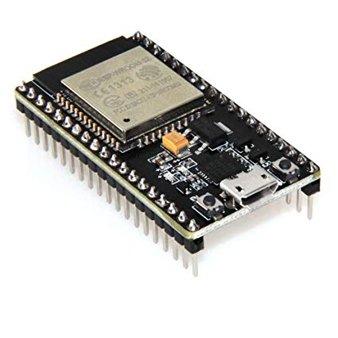
UDP ESP32
WIRELESS ROUTER
IP 192.168.1.1
DEFAULT IP
NOTEBOOK
IP 192.168.1.9
IP YOU CAN SET MANUAL OR AUTOMATIC
ESP-WROOM-32
192.168.1.2
IP GET AUTOMATIC FROM WIRELESS ROUTER

